Slide 1
Fermentation Data Analysis (and other time course experiments)
Steve Van Dien
Nov. 29, 2018

Slide 2
Agenda
Overview
Step-by-step demonstration of calculations, with example
Conceptual example – fatty acids in yeast
Hands on example using raw data spreadsheets – serine in E. coli

Slide 3
Fermentation Overview
Benefits of Fermentation
Tuning and control of aeration
pH control
Substrate feeding
Off-gas analysis
Facilitates time-course sampling
Objectives of Fermentation Experiments
Evaluation of milestone strains at process conditions
New strain evaluation
Condition optimization- aeration, media, pH, temp
Detailed strain evaluation
Diagnostic experiments
Scale-up
High cell density and product titer
Accurate calculation of rates

Slide 4
Calculation of Rates in Fermentation
Calculation of specific rates (mmol/gDCW-hr) over each time interval facilitates understanding of cell physiology
Independent of volume changes
Inputs for constraint-based modeling
How to get there
Determine all system inputs, outputs, and accumulation
Convert to cumulative mmoles of each produced or consumed
Evaluate carbon balance
Calculate average specific rate over any time interval
Calculate specific rates at each time point (various methods)

Slide 5

Calculation of Liquid Volume
Accurate liquid volume needed to convert concentrations to amounts
$${Vol}_{t}={Vol}_{0}+\left[\sum{V_{Sub1}∆t}+\sum{V_{Sub2}∆t}\right]+\frac{B}{1000}−\frac{V_{samp}}{1000}$$
Total amount of each substrate fed
Initial volume
Volume of base (or acid) fed
Volume of samples taken
Does not account for
Loss of water vapor or volatile liquids in off-gas
Changes in broth density
Water produced or consumed during metabolism

Slide 6
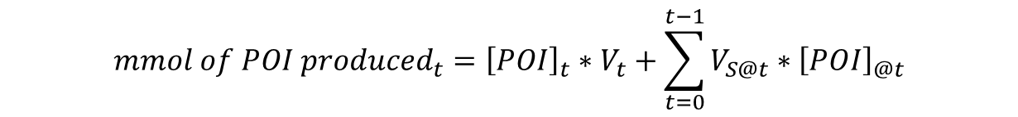
Products and Byproducts Formed
At any given time (t), total product formed is the amount in the tank at time t plus all removed by sampling
$${mmol of POI produced}_{t}={\left[POI\right]}_{t}∗V_{t}+\sum_{t=0}^{t−1}{V_{S@t}}∗{\left[POI\right]}_{@t}$$
Product of Interest
Amount in tank = conc x volume at t
Amount in sample = conc x vol
at each time point
Analogous equations for all soluble byproducts

Slide 7
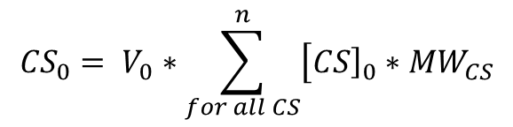

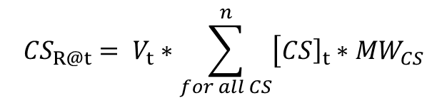
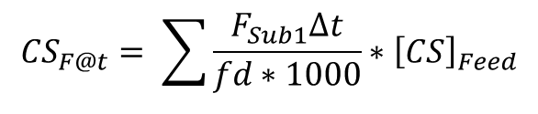

Carbon Source Consumed
$${g of CS consumed}_{t}={CS}_{0}+{CS}_{F@t}+\sum_{t=0}^{t}{{CS}_{B}}−{CS}_{R@t}− \sum_{t=0}^{t−1}{{CS}_{S@t}}$$
$${CS}_{0}= V_{0}∗\sum_{for all CS}^{n}{\left[{\left.CS\right]}_{0}∗{MW}_{CS}\right.}$$
Initial CS:
Continuous feed
$${CS}_{F@t}= \sum{\frac{F_{Sub1}∆t}{fd∗1000}}∗{\left[CS\right]}_{Feed}$$
F = volumetric flowrate
Can also measure weight if feed on scale
Bolus feed
$${CS}_{B}= V_{B}∗{\left[CS\right]}_{Feed}$$
(Often zero)
$${CS}_{R@t}= V_{t}∗\sum_{for all CS}^{n}{\left[{\left.CS\right]}_{t}∗{MW}_{CS}\right.}$$
Residual:

Slide 8
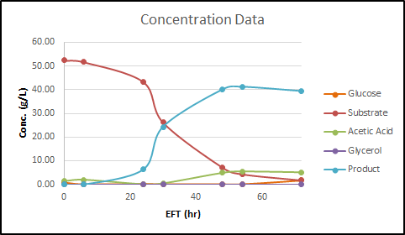
Example: Biotransformation
Cells are grown on glucose, then pathway is induced to convert substrate to product
Aerobic process – oxidative biotransformation

Slide 9
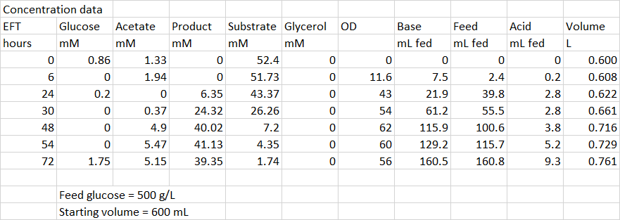
Example: Biotransformation

Slide 10
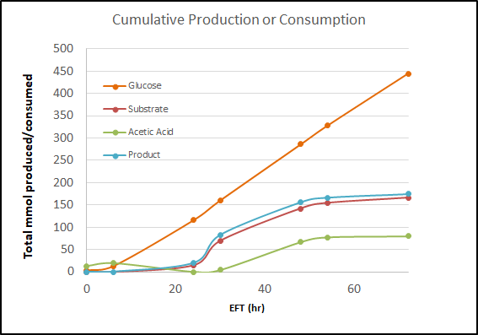
Consumption and Production

Slide 11
Product and Byproduct Yields
Once the product formed and carbon source consumed are determined, yields can be calculated
$${Mass Yield}_{t}=\frac{{\left(g of POI produced\right)}_{t}}{{\left(g of CS consumed in ferm\right)}_{t}+g of CS consumed in seed}$$
$${Molar yield}_{t}=\frac{{\left(mmol of POI produced\right)}_{t}}{{\left(mmol of CS cons in ferm\right)}_{t}+mmol of CS cons in seed}$$
Calculate amount of CS consumed in seed based on volume of inoculum, not entire seed tank
In not measured, can estimate:
$$g of CS consumed in seed=\frac{\left(V_{0}∗{OD}_{0}∗ODconversion\right)}{Biomass Yield in Seed}$$

Slide 12
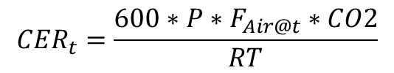
Off-gas Calculations
Oxygen uptake rate (OUR) and CO₂ evolution rate (CER) are calculated from off-gas analysis
Units are mmol/hr
$${OUR}_{t}=P∗{\left(F\right.}_{Air@t}∗60∗\frac{X−O2}{100})/{\frac{RT}{1000}}=\frac{\left.600∗P∗F_{Air@t}∗(X−O2\right)}{RT}$$
$${CER}_{t}=\frac{600∗P∗F_{Air@t}∗CO2}{RT}$$
O2 and CO2 are the mol% of each in the off-gas
F_{air} is the air flowrate at a given time, L/min
P is the pressure (atm), T is temperature in K
X is the inlet %O2, equal to 21% for pure air
Cumulative amount of O₂ consumed or CO₂ produced is calculated by integrating up to time t

Slide 13
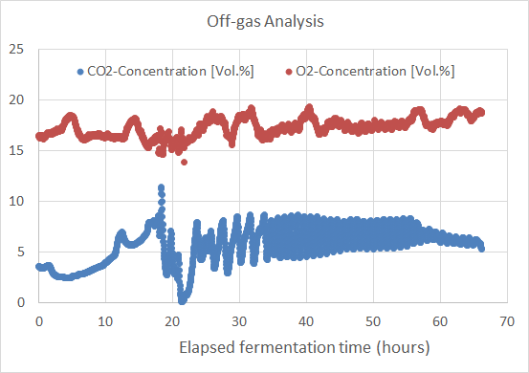
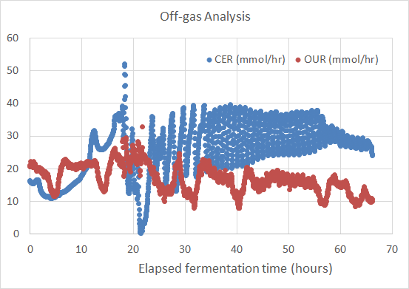
Off-gas Analysis

Slide 14
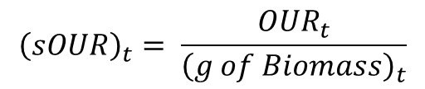
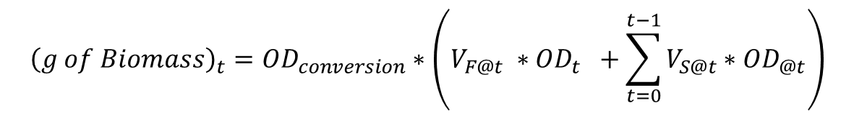
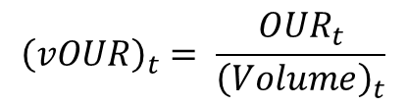
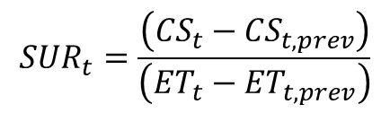
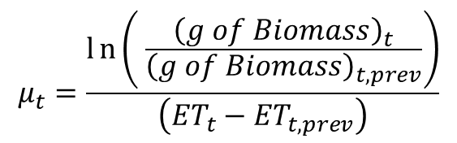
Other Calculations
Biomass:
$${\left(g of Biomass\right)}_{t}={OD}_{conversion}∗\left(V_{F@t} {∗OD}_{t} +\sum_{t=0}^{t−1}{V_{S@t}}∗{OD}_{@t}\right)$$
$$μ_{t}=\frac{ln\left( \frac{{\left(g of Biomass\right)}_{t}}{{\left(g of Biomass\right)}_{t,prev}}\right)}{\left({ET}_{t}−{ET}_{t,prev}\right)}$$
Growth Rate:
$${\left(sOUR\right)}_{t}= \frac{{OUR}_{t}}{{\left(g of Biomass\right)}_{t}}$$
Specific OUR:
$${\left(vOUR\right)}_{t}= \frac{{OUR}_{t}}{{\left(Volume\right)}_{t}}$$
Volumetric OUR:
$${SUR}_{t}=\frac{\left({CS}_{t}−{CS}_{t,prev}\right)}{\left({ET}_{t}−{ET}_{t,prev}\right)}$$
Substrate Uptake Rate:

Slide 15
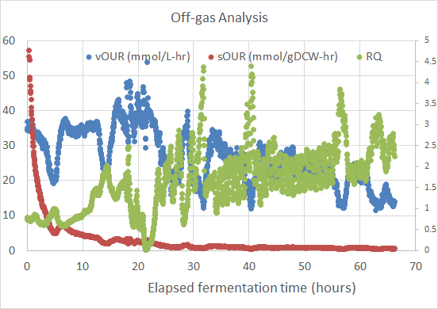
Off-gas Analysis
Respiratory quotient: RQ = CER/OUR
RQ > 1 may indicate oxygen limitation

Slide 16
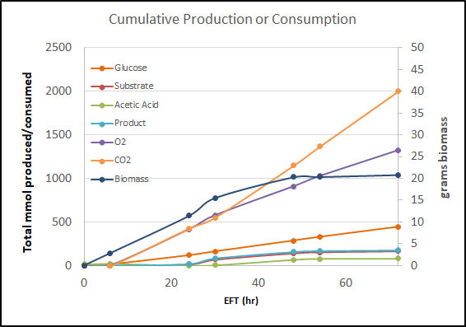
Total mmoles produced or consumed

Slide 17
Interval Uptake and Production Rates
Product (or any liquid-phase byproduct):
$${\left(Inst POI Mass Rate\right)}_{t}=\frac{\left(\left({\left.g POI produced\right)}_{t}−({\left.g POI produced\right)}_{t−1}\right.\right)}{\left({ET}_{t}−{ET}_{t−1}\right)}$$
$${\left(Inst POI Molar Rate\right)}_{t}=\frac{\left(\left({\left.mmol POI produced\right)}_{t}−({\left.mmol POI produced\right)}_{t−1}\right.\right)}{\left({ET}_{t}−{ET}_{t−1}\right)}$$
Analogous equations for substrate uptake
Can also determine specific rates – divide by average biomass
Can also calculate interval yields at each time point
$${\left(Inst POI Yield mol/mol\right)}_{t}=\frac{{\left(Inst Sp POI Productivity Molar\right)}_{t}}{{\left(Inst Sp SUR Molar\right)}_{t}}$$

Slide 18
Interval Uptake and Production Rates
Warning!
Calculated rates are just an approximation of derivative of cumulative mmol plot – usually based on sparse sampling
Specific rates have additional uncertainty of biomass measurement
Various ways to calculate, potentially giving different results if sampling is infrequent
Use t and t-1
Use t+1 and t-1
Use average biomass or estimate based on growth rate?
Curve fitting followed by analytical differentiation may be the most accurate

Slide 19
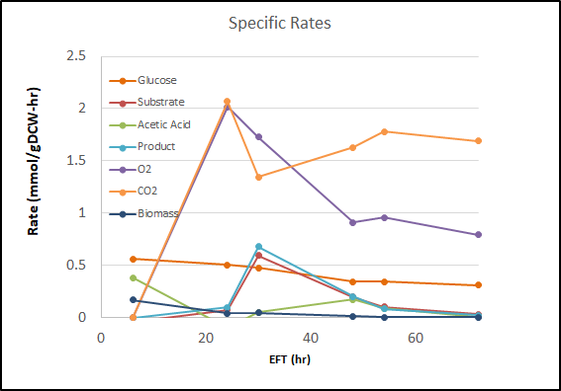
Rates Calculated for Example

Slide 20
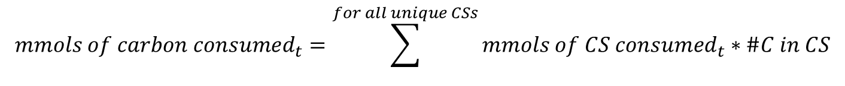
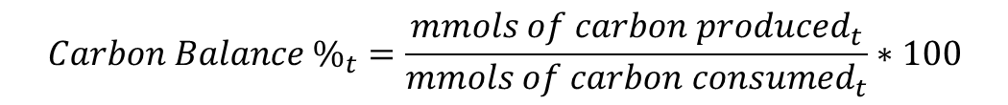
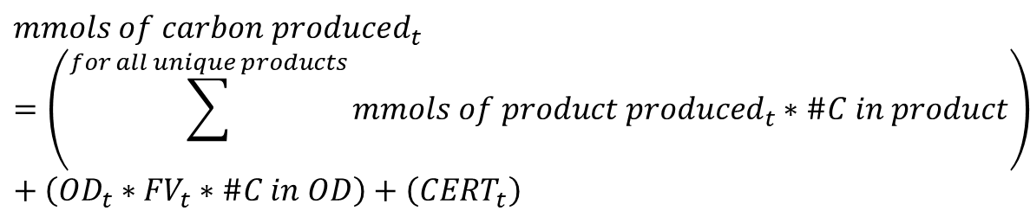
Carbon Balance
Carbon balance is useful to determine the quality of the measurements, and used to track down missing products.
$${Carbon Balance \%}_{t}=\frac{{mmols of carbon produced}_{t}}{{mmols of carbon consumed}_{t}}∗100$$
$${mmols of carbon consumed}_{t}=\sum^{for all unique CSs}{{mmols of CS consumed}_{t}∗\#C in CS}$$
$${mmols of carbon produced}_{t}=\left(\sum^{for all unique products}{{mmols of product produced}_{t}∗\#C in product}\right)+\left({OD}_{t}∗{FV}_{t}∗\#C in OD\right)+\left({CERT}_{t}\right)$$
For E. coli, #C in OD determined to be about 17

Slide 21
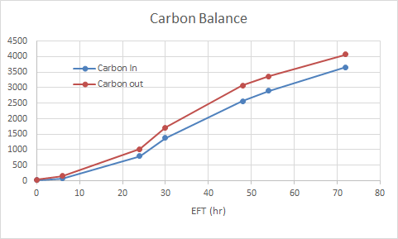
Carbon Balance
Carbon in lower than carbon out because uptake from rich media is not measured

Slide 22
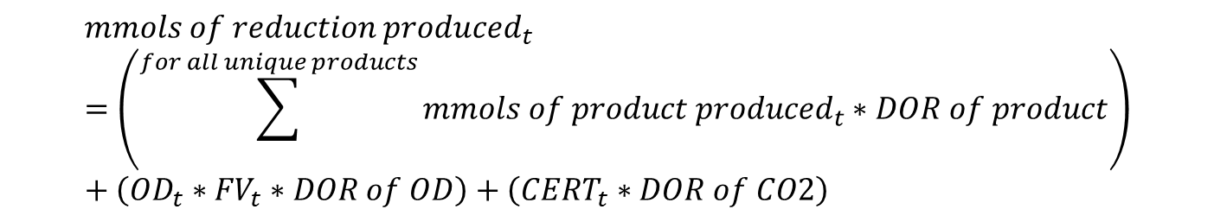
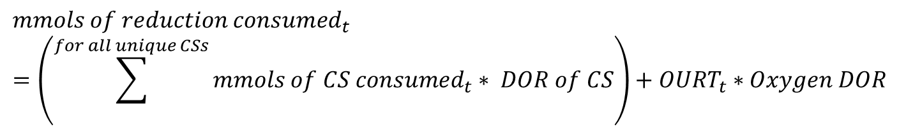
Degree of Reduction Balance
Useful for QC, especially for oxygen measurement
Generally not as accurate as carbon balance
$${mmols of reduction consumed}_{t}=\left(\sum^{for all unique CSs}{{mmols of CS consumed}_{t}∗ DOR of CS}\right)+{OURT}_{t}∗Oxygen DOR$$
$${mmols of reduction produced}_{t}=\left(\sum^{for all unique products}{{mmols of product produced}_{t}∗DOR of product}\right)+\left({OD}_{t}∗{FV}_{t}∗DOR of OD\right)+\left({CERT}_{t}∗DOR of CO2\right)$$
For any compound C_{a}H_{b}O_{c}N_{d} S_{e}P_{f} , DOR = 4a + b –2c – 3d + 6e + 5f

Slide 23
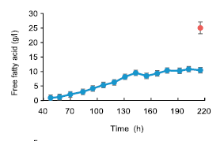
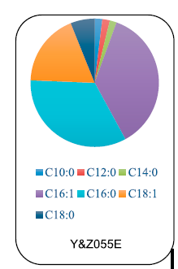
Example – Fatty Acid Production in Yeast
Removed PDC genes to prevent ethanol production
Added citrate lyase to generate cytosolic acetyl-CoA
Inserted heterologous pathway for free fatty acid synthesis

Slide 24
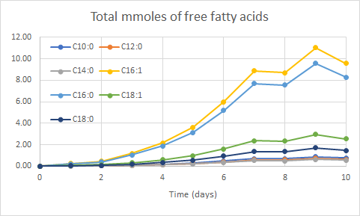
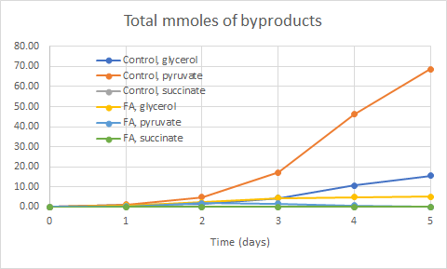
Example – Fatty Acid Production in Yeast
Convert all data to cumulative mmoles produced

Slide 25
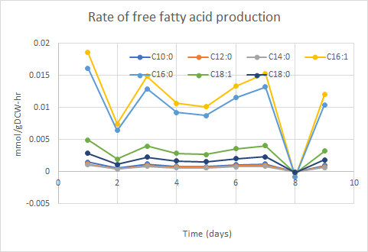
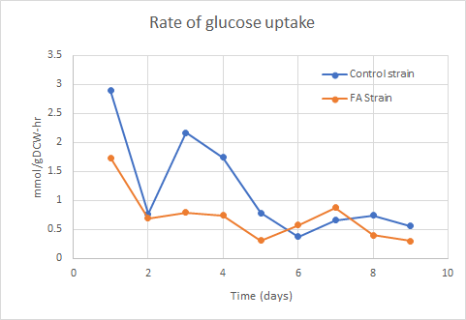
Example – Fatty Acid Production in Yeast
Calculate rates over each time interval

